Slide 1
Natural language PROCESSING (nlp)
Presented By: Ujjwal Dhakal Student Id: 1222290
Tutor: Yi Hu Unit Coordinator: Harita Chugh
Date: 28-04-2023

Slide 2
Questions:
1. Let’s start with the popular ChatGPT these days. Any idea about the backbone of this technology?
2. Similarly, voice assistants such as Siri, Alexa, Cortana, etc. are pretty common today. Can you guess the technology behind all these?
3. Language translation tools are important innovation. What powers them exactly?

Slide 3
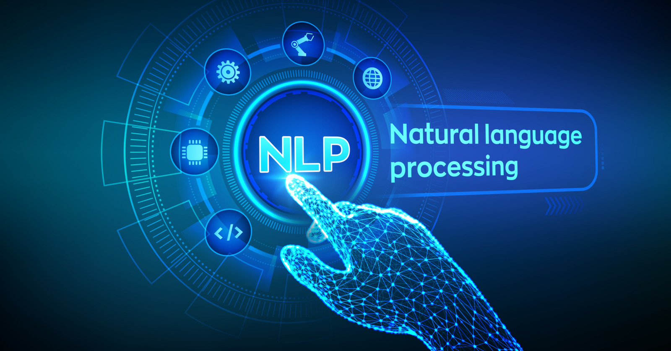
Yup. Here is the answer.
Source: (Conversational AI Platform, 2021)

Slide 4

Gesture Plan
Standing right infront on the stage
01
Hand Gestures
02
Exposed Palms for openness.
03
Thumb gesture for emphasis
04

Slide 5
AGENDAS
Introduction to Natural Language Processing (NLP)
History of NLP
Phases Involved in NLP
Importance of NLP
Application of NLP
Challenges of NLP
Conclusion & Summary

Slide 6
Introduction
According to (Eisenstein, 2019):
natural language are languages spoken by people
method for making human language accessible to computers
reduce distance between human and machine
Recognition -> Natural Language Understanding -> Natural Language Generation -> Response

Slide 7
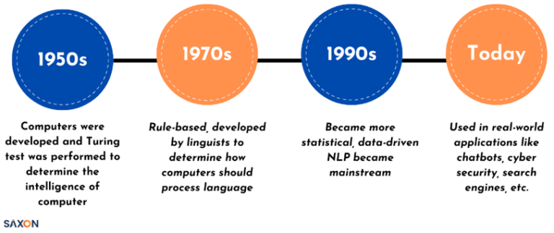
History
Source: (Kandukuri, 2022)

Slide 8
Fun Fact
ELIZA is first chatterbot built in 1996 which is best known for acting in the manner of a psychotherapies. It was used for communication among humans and machines
Source: (Wikipedia Contributors, 2019)

Slide 9
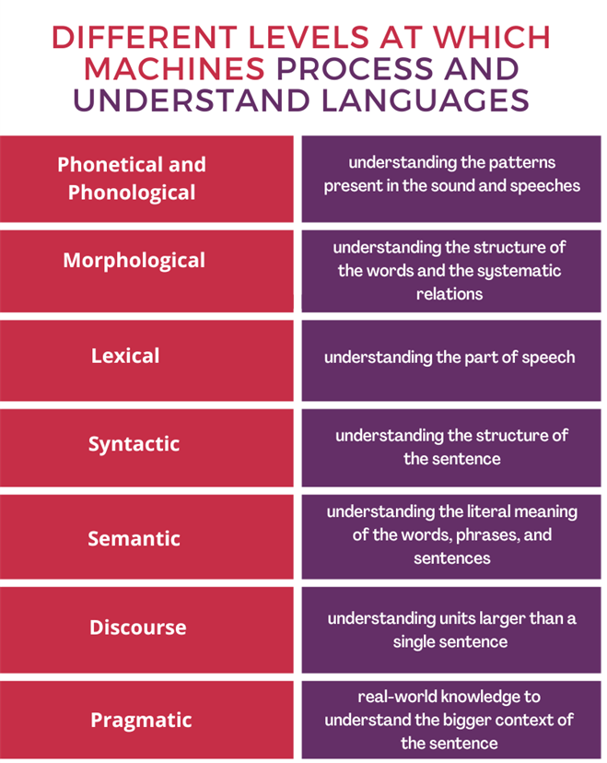
PHASES in NLP
Source: (Kandukuri, 2022)

Slide 10


Importance
1. Refines human-computer interaction
2. Automates repetitive tasks
Example:
-automated text summarization
3. Enhances decision making
4. Improves accessibility
5. Upgrades information retrieval
These points has been taken from (GeeksforGeeks, 2018).

Slide 11
APPLICATIONs
From (Lutkevich, 2021) we can find some applications of NLP like:
Word processors for plagiarism and proofreading
Automatic translation
Customer service automation
Analysis and categorization of medical records
Customer feedback analysis
Academic research and analysis
Automation of routine litigation tasks

Slide 12
CHALLENGES
1. Contextual words and phrases
2. Handling word variations
3. Generating ambiguous responses
4. Errors in speech or text
5. Problems with informal languages
6. Domain-specific language

Slide 13
Conclusion & Summary
NLP analyzes human language.
Large language models enhances NLP.
It has various applications.
NLP faces contextual challenges.
It may revolutionize communication paradigm.

Slide 14
REFERENCES
Conversational AI Platform. (2021). What Is Natural Language Processing? [online] Available at: https://www.asksid.ai/ai/what-is-natural-language-processing/ [Accessed 24 Apr. 2023].
Eisenstein, J. (2019). Introduction to natural language processing. Cambridge, Massachusetts: The Mit Press.
Kandukuri, G. (2022). NLP powers human language understanding of machines. [online] Saxon. Available at: https://saxon.ai/blogs/natural-language-processing-in-ai/ [Accessed 25 Apr. 2023].
GeeksforGeeks. (2018). Introduction to Natural Language Processing. [online] Available at: https://www.geeksforgeeks.org/introduction-to-natural-language-processing/. [Accessed 24 Apr. 2023].
Wikipedia Contributors (2019). ELIZA. [online] Wikipedia. Available at: https://en.wikipedia.org/wiki/ELIZA. [Accessed 27 Apr. 2023].

